Slide 1
Generating Families of Practical Fast Matrix Multiplication Algorithms
Jianyu Huang, Leslie Rice,
Devin A. Matthews, Robert A. van de Geijn
The University of Texas at Austin
Jianyu Huang, Leslie Rice,
Devin A. Matthews, Robert A. van de Geijn
IPDPS2017, May 31st, Orlando, FL

Slide 2
Outline
Background
High-performance GEMM
High-performance Strassen
Fast Matrix Multiplication (FMM)
Code Generation
Performance Model
Experiments
Conclusion

Slide 3
High-performance matrix multiplication (GEMM)

Slide 4
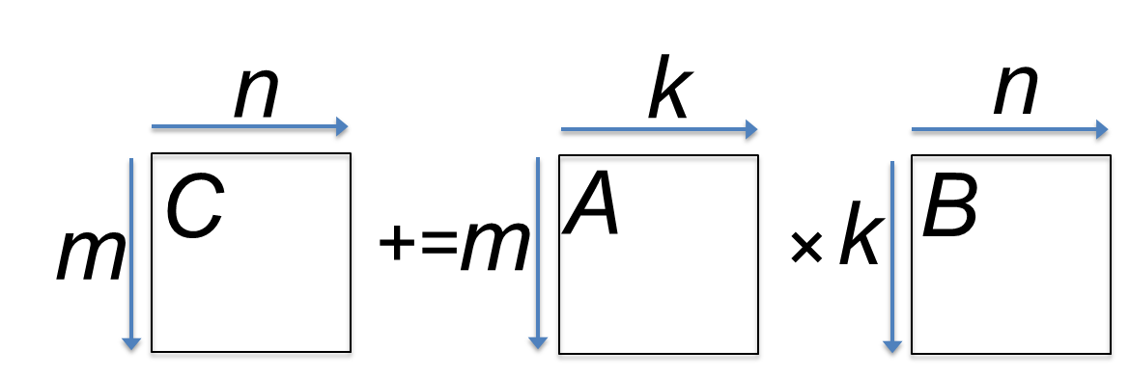
State-of-the-art GEMM in BLIS
BLAS-like Library Instantiation Software (BLIS) is a portable framework for instantiating BLAS-like dense linear algebra libraries.
BLIS provides a refactoring of GotoBLAS algorithm (best-known approach on CPU) to implement GEMM.
GEMM implementation in BLIS has 6-layers of loops. The outer 5 loops are written in C. The inner-most loop (micro-kernel) is written in assembly for high performance.
Field Van Zee, and Robert van de Geijn. “BLIS: A Framework for Rapidly Instantiating BLAS Functionality.” ACM TOMS 41.3 (2015): 14.
Kazushige Goto, and Robert van de Geijn. “High-performance implementation of the level-3 BLAS.” ACM TOMS 35.1 (2008): 4.
Kazushige Goto, and Robert van de Geijn. “Anatomy of high-performance matrix multiplication.” ACM TOMS 34.3 (2008): 12.

Slide 5
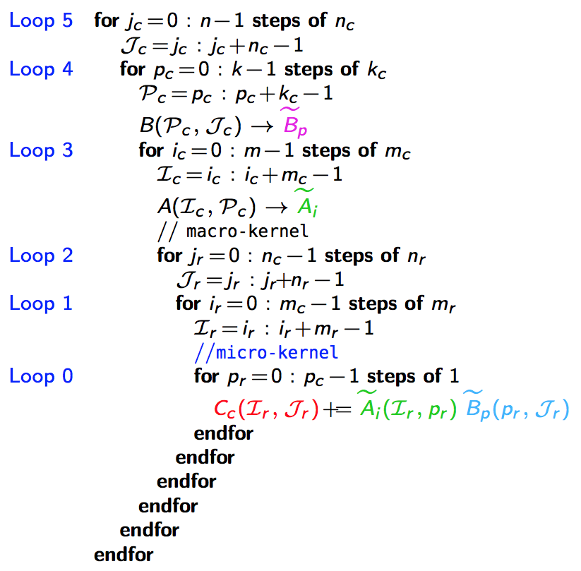
GotoBLAS algorithm for GEMM in BLIS
k_{C} x n_{C}
L3 Cache
m_{C} x k_{C}
L2 Cache
m_{R} x n_{R}
*Field G. Van Zee, and Tyler M. Smith. “Implementing high-performance complex matrix multiplication via the 3m and 4m methods.” In ACM Transactions on Mathematical Software (TOMS), accepted.
Register
m_{R} x k_{C}
k_{C} x n_{R}

Slide 6
High-performance Strassen
*Jianyu Huang, Tyler Smith, Greg Henry, and Robert van de Geijn. “Strassen’s Algorithm Reloaded.” In SC’16.

Slide 7
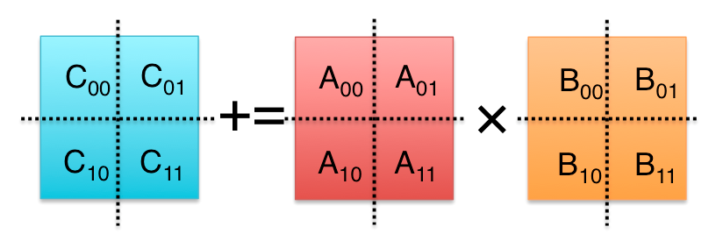
Strassen’s Algorithm Reloaded
M₀ := (A₀₀+A₁₁)(B₀₀+B₁₁);
M₁ := (A₁₀+A₁₁)B₀₀;
M₂ := A₀₀(B₀₁–B₁₁);
M₃ := A₁₁(B₁₀–B₀₀);
M₄ := (A₀₀+A₀₁)B₁₁;
M₅ := (A₁₀–A₀₀)(B₀₀+B₀₁);
M₆ := (A₀₁–A₁₁)(B₁₀+B₁₁);
C₀₀ += M₀ + M₃ – M₄ + M₆
C₀₁ += M₂ + M₄
C₁₀ += M₁ + M₃
C₁₁ += M₀ – M₁ + M₂ + M₅
M₀ := (A₀₀+A₁₁)(B₀₀+B₁₁); C₀₀ += M₀; C₁₁ += M₀;
M₁ := (A₁₀+A₁₁)B₀₀; C₁₀ += M₁; C₁₁ –= M₁;
M₂ := A₀₀(B₀₁–B₁₁); C₀₁ += M₂; C₁₁ += M₂;
M₃ := A₁₁(B₁₀–B₀₀); C₀₀ += M₃; C₁₀ += M₃;
M₄ := (A₀₀+A₀₁)B₁₁; C₀₁ += M₄; C₀₀ –= M₄;
M₅ := (A₁₀–A₀₀)(B₀₀+B₀₁); C₁₁ += M₅;
M₆ := (A₀₁–A₁₁)(B₁₀+B₁₁); C₀₀ += M₆;
M := (X+Y)(V+W); C +=M; D +=M;
M := (X+δY)(V+εW); C += γ₀M; D += γ₁M;
γ₀, γ₁,δ,ε ∈ {-1, 0, 1}.
General operation for one-level Strassen:

Slide 8
M := (X+δY)(V+εW); C += γ₀M; D += γ₁M;
γ₀, γ₁,δ,ε ∈ {-1, 0, 1}.
M := (X+Y)(V+W); C += M; D += M;

Slide 9
M := (X+δY)(V+εW); C += γ₀M; D += γ₁M;
γ₀, γ₁,δ,ε ∈ {-1, 0, 1}.
C += AB;
M := (X+Y)(V+W); C += M; D += M;

Slide 10
M := (X+δY)(V+εW); C += γ₀M; D += γ₁M;
γ₀, γ₁,δ,ε ∈ {-1, 0, 1}.
C += AB;
M := (X+Y)(V+W); C += M; D += M;
k_{C} x n_{C}
L3 Cache
m_{C} x k_{C}
L2 Cache
m_{R} x n_{R}
Register

Slide 11
Outline
Background
High-performance GEMM
High-performance Strassen
Fast Matrix Multiplication (FMM)
Code Generation
Performance Model
Experiments
Conclusion

Slide 12
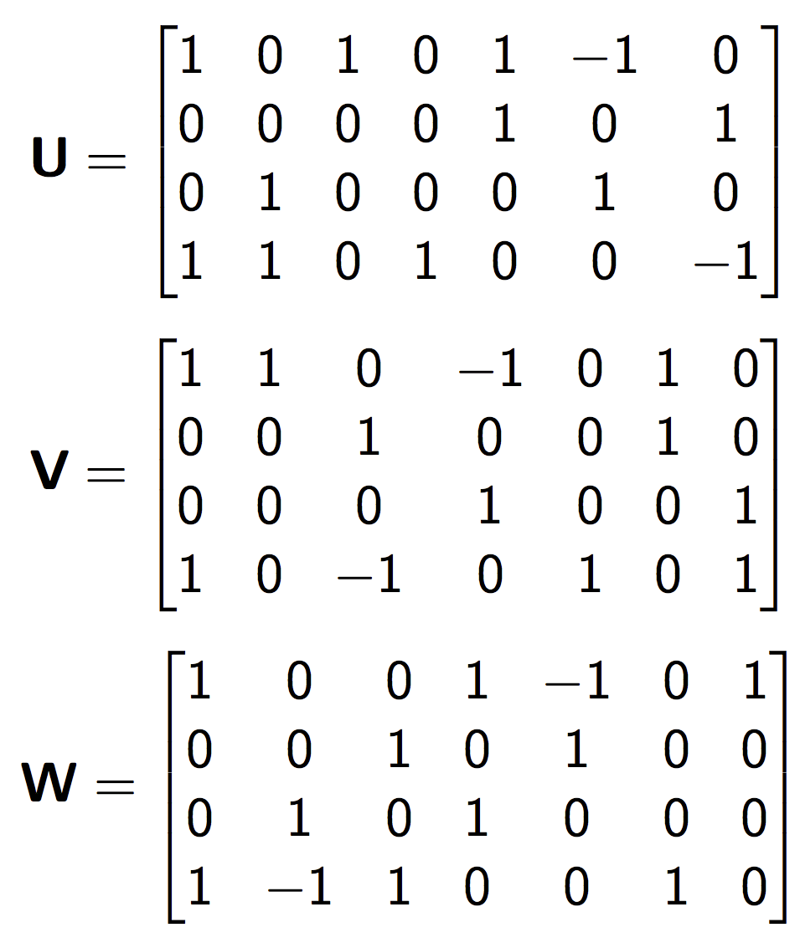
<2,2,2> Strassen’s Algorithm
M₀ := (A₀+A₃)(B₀+B₃); C₀ += M₀; C₃ += M₀;
M₁ := (A₂+A₃)B₀; C₂ += M₁; C₃ –= M₁;
M₂ := A₀(B₁–B₃); C₁ += M₂; C₃ += M₂;
M₃ := A₃(B₂–B₀); C₀ += M₃; C₂ += M₃;
M₄ := (A₀+A₁)B₃; C₁ += M₄; C₀ –= M₄;
M₅ := (A₂–A₀)(B₀+B₁); C₃ += M₅;
M₆ := (A₁–A₃)(B₂+B₃); C₀ += M₆;

Slide 13
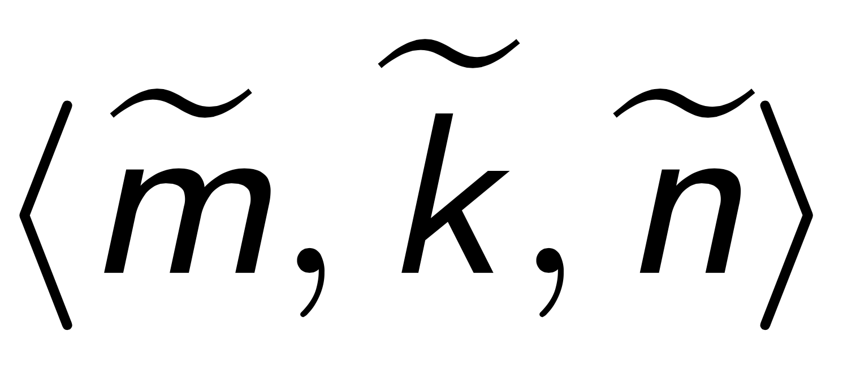
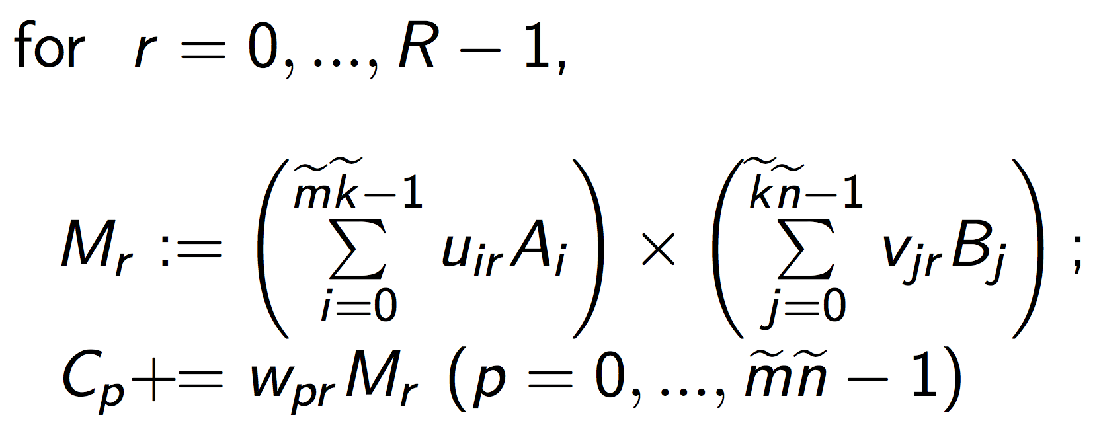
Fast Matrix Multiplication (FMM)

Slide 14
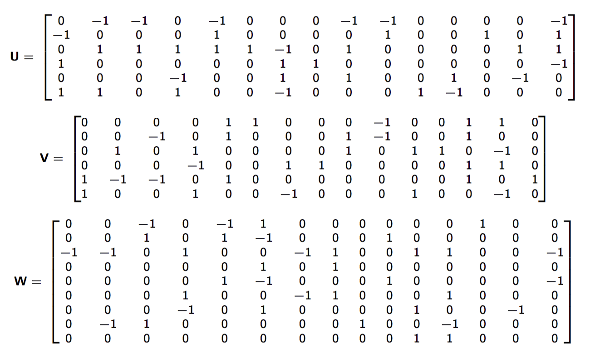
<3,2,3> Fast Matrix Multiplication (FMM)
M₀ := (–A₁+A₃+A₅)(B₄+B₅); C₂ –= M₀;
M₁ := (–A₀+A₂+A₅)(B₀–B₅); C₂ –= M₁; C₇ –= M₁;
M₂ := ( –A₀+A₂ )( –B₁–B₄ ); C₀–=M₂;C₁+=M₂;C₇+=M₂;
M₃ := ( A₂–A₄+A₅ )( B₂–B₃+B₅ ); C₂+=M₃;C₅+=M₃;C₆–=M₃;
M₄ := ( –A₀+A₁+A₂ )( B₀+B₁+B₄ ); C₀–=M₄;C₁+=M₄;C₄+=M₄;
M₅ := ( A₂ )( B₀ ); C₀+=M₅;C₁–=M₅;C₃+=M₅;C₄–=M₅;C₆+=M₅;
M₆ := ( –A₂+A₃+A₄–A₅ )( B₃–B₅ ); C₂–=M₆;C₅–=M₆;
M₇ := ( A₃ )( B₃ ); C₂+=M₇;C₃+=M₇;C₅+=M₇;
M₈ := ( –A₀+A₂+A₄ )( B₁+B₂ ); C₇+=M₈;
M₉ := ( –A₀+A₁ )( –B₀–B₁ ); C₁+=M₉;C₄+=M₉;
M₁₀ :=( A₅ )( B₂+B₅ ); C₂+=M₁₀;C₆+=M₁₀;C₈+=M₁₀;
M₁₁ := ( A₄–A₅ )( B₂ ); C₂+=M₁₁;C₅+=M₁₁;C₇–=M₁₁;C₈+=M₁₁;
M₁₂ := ( A₁ )( B₀+B₁+B₃+B₄ ); C₀+=M₁₂;
M₁₃ := ( A₂–A₄ )( B₀–B₂+B₃–B₅ ); C₆–=M₁₃;
M₁₄ := ( –A₀+A₁+A₂–A₃ )( B₅ ); C₂–=M₁₄;C₄–=M₁₄;
*Austin R. Benson, Grey Ballard. "A framework for practical parallel fast matrix multiplication." PPoPP15.
M0=( -A(0,1)+A(1,1)+A(2,1) )( B(1,1)+B(1,2) );
C(0,2)-=M0;
M1=( -A(0,0)+A(1,0)+A(2,1) )( B(0,2)-B(1,1) );
C(0,2)-=M1;C(2,1)-=M1;
M2=( -A(0,0)+A(1,0) )( -B(0,1)-B(1,1) );
C(0,0)-=M2;C(0,1)+=M2;C(2,1)+=M2;
M3=( A(1,0)-A(2,0)+A(2,1) )( B(0,2)-B(1,0)+B(1,2) );
C(0,2)+=M3;C(1,2)+=M3;C(2,0)-=M3;
M4=( -A(0,0)+A(0,1)+A(1,0) )( B(0,0)+B(0,1)+B(1,1) );
C(0,0)-=M4;C(0,1)+=M4;C(1,1)+=M4;
M5=( A(1,0) )( B(0,0) );
C(0,0)+=M5;C(0,1)-=M5;C(1,0)+=M5;C(1,1)-=M5;C(2,0)+=M5;
M6=( -A(1,0)+A(1,1)+A(2,0)-A(2,1) )( B(1,0)-B(1,2) );
C(0,2)-=M6;C(1,2)-=M6;
M7=( A(1,1) )( B(1,0) );
C(0,2)+=M7;C(1,0)+=M7;C(1,2)+=M7;
M8=( -A(0,0)+A(1,0)+A(2,0) )( B(0,1)+B(0,2) );
C(2,1)+=M8;
M9=( -A(0,0)+A(0,1) )( -B(0,0)-B(0,1) );
C(0,1)+=M9;C(1,1)+=M9;
M10=( A(2,1) )( B(0,2)+B(1,2) );
C(0,2)+=M10;C(2,0)+=M10;C(2,2)+=M10;
M11=( A(2,0)-A(2,1) )( B(0,2) );
C(0,2)+=M11;C(1,2)+=M11;C(2,1)-=M11;C(2,2)+=M11;
M12=( A(0,1) )( B(0,0)+B(0,1)+B(1,0)+B(1,1) );
C(0,0)+=M12;
M13=( A(1,0)-A(2,0) )( B(0,0)-B(0,2)+B(1,0)-B(1,2) );
C(2,0)-=M13;
M14=( -A(0,0)+A(0,1)+A(1,0)-A(1,1) )( B(1,1) );
C(0,2)-=M14;C(1,1)-=M14;

Slide 15
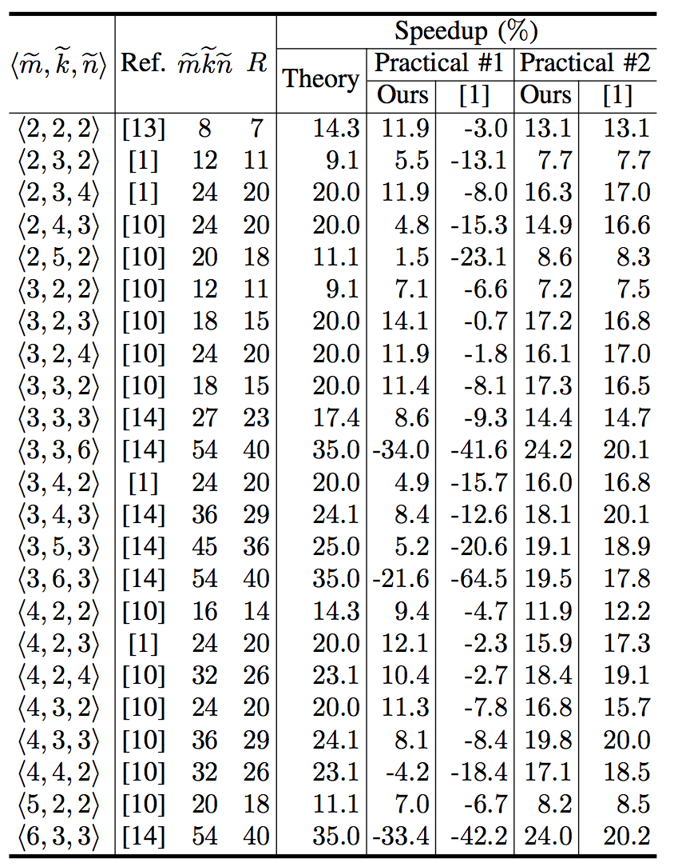

Slide 18
* [1] Austin R. Benson, Grey Ballard. "A framework for practical parallel fast matrix multiplication." PPoPP15.

Slide 19
M := (X+δY)(V+εW); C += γ₀M; D += γ₁M;
γ₀, γ₁,δ,ε ∈ {-1, 0, 1}.
C += AB;
M := (X+Y)(V+W); C += M; D += M;
k_{C} x n_{C}
L3 Cache
m_{C} x k_{C}
L2 Cache
m_{R} x n_{R}
Register

Slide 20
* [1] Austin R. Benson, Grey Ballard. "A framework for practical parallel fast matrix multiplication." PPoPP15.

Slide 21
* [1] Austin R. Benson, Grey Ballard. "A framework for practical parallel fast matrix multiplication." PPoPP15.

Slide 22
One-level Fast Matrix Multiplication (FMM)

Slide 23
Two-level Fast Matrix Multiplication (FMM)

Slide 24
Kronecker Product
m x n
p x q
(mp) x (nq)
https://en.wikipedia.org/wiki/Kronecker_product.
https://en.wikipedia.org/wiki/Tensor_product

Slide 25
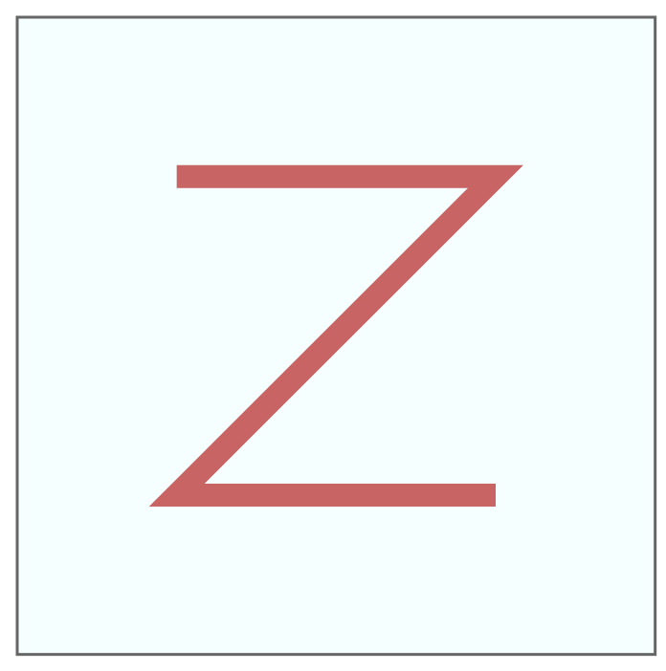
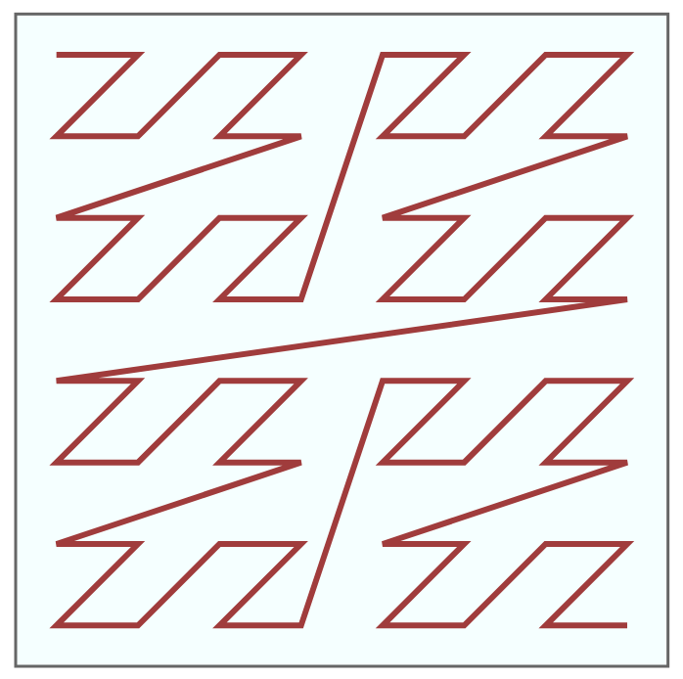
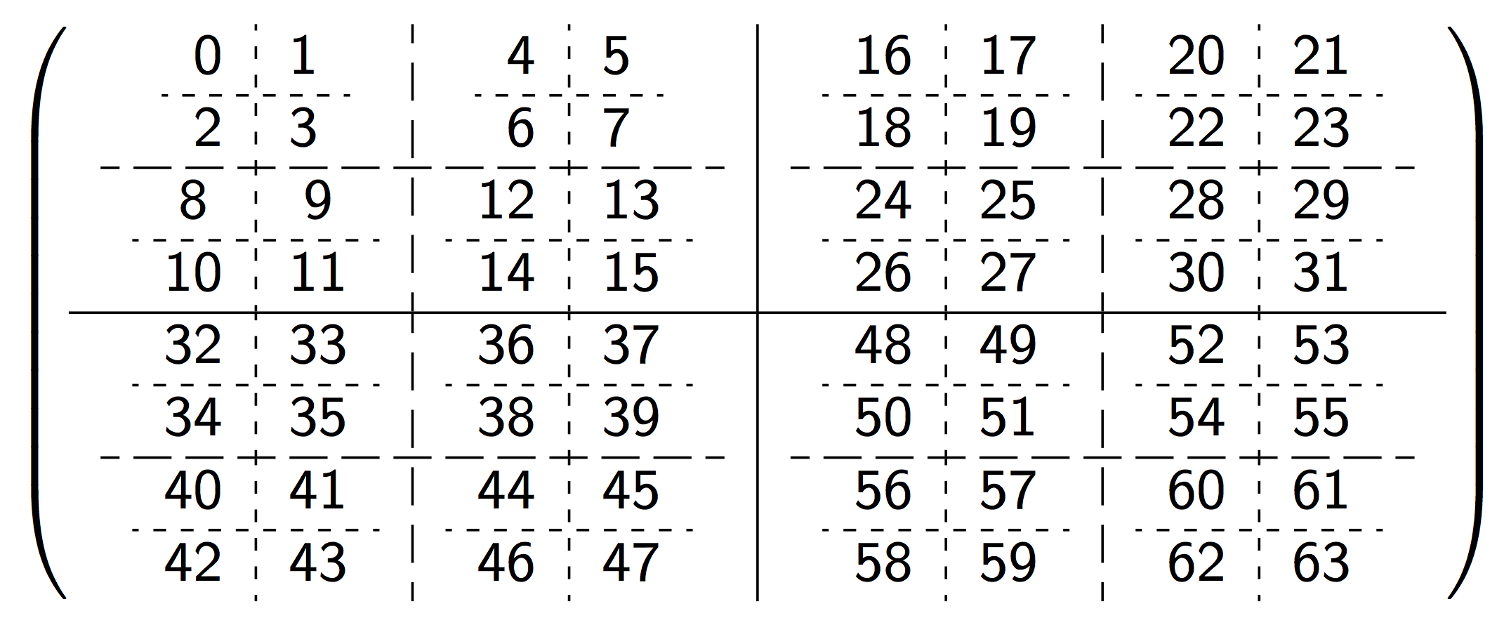
Morton-like Ordering
* https://en.wikipedia.org/wiki/Z-order_curve.

Slide 26
Two-level Fast Matrix Multiplication

Slide 27
Two-level Fast Matrix Multiplication
2-level Morton-like ordering index

Slide 28
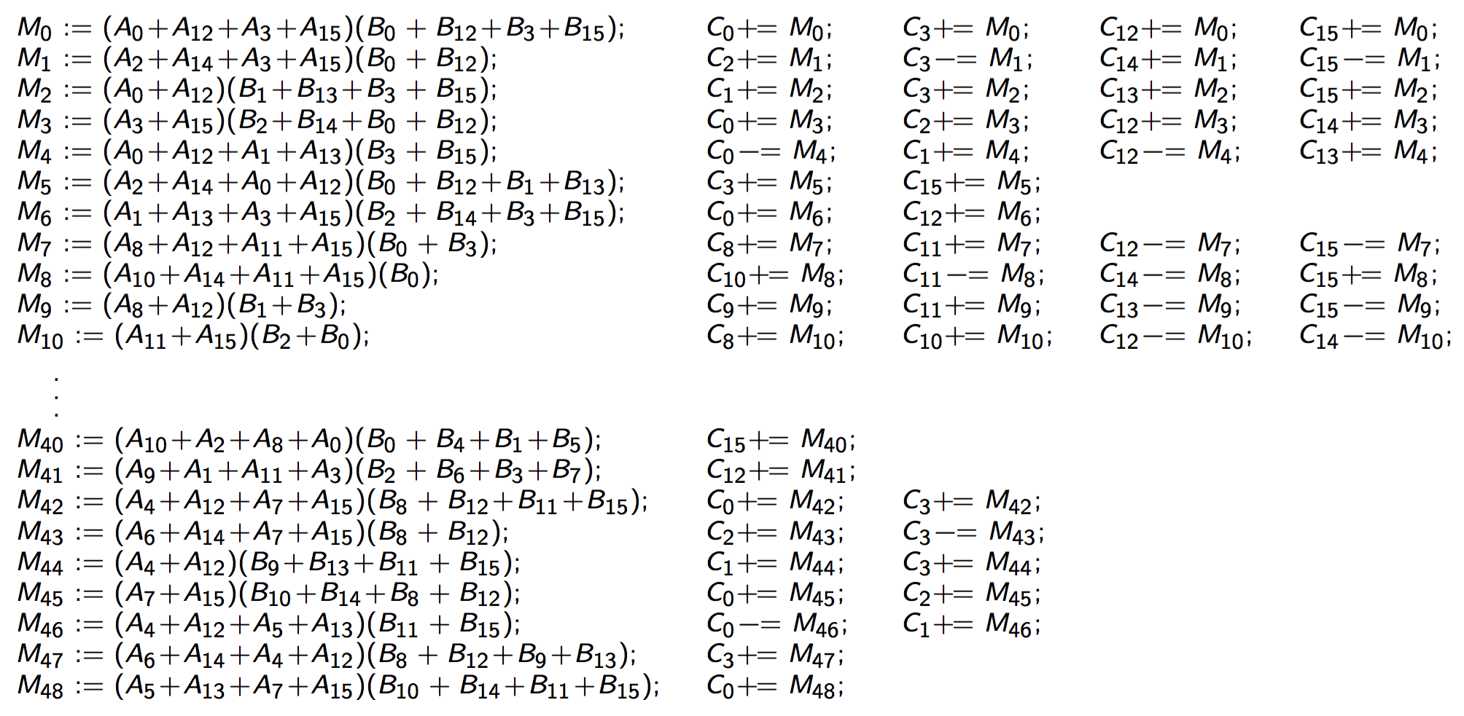
Two-level <2,2,2> Strassen Algorithm

Slide 29
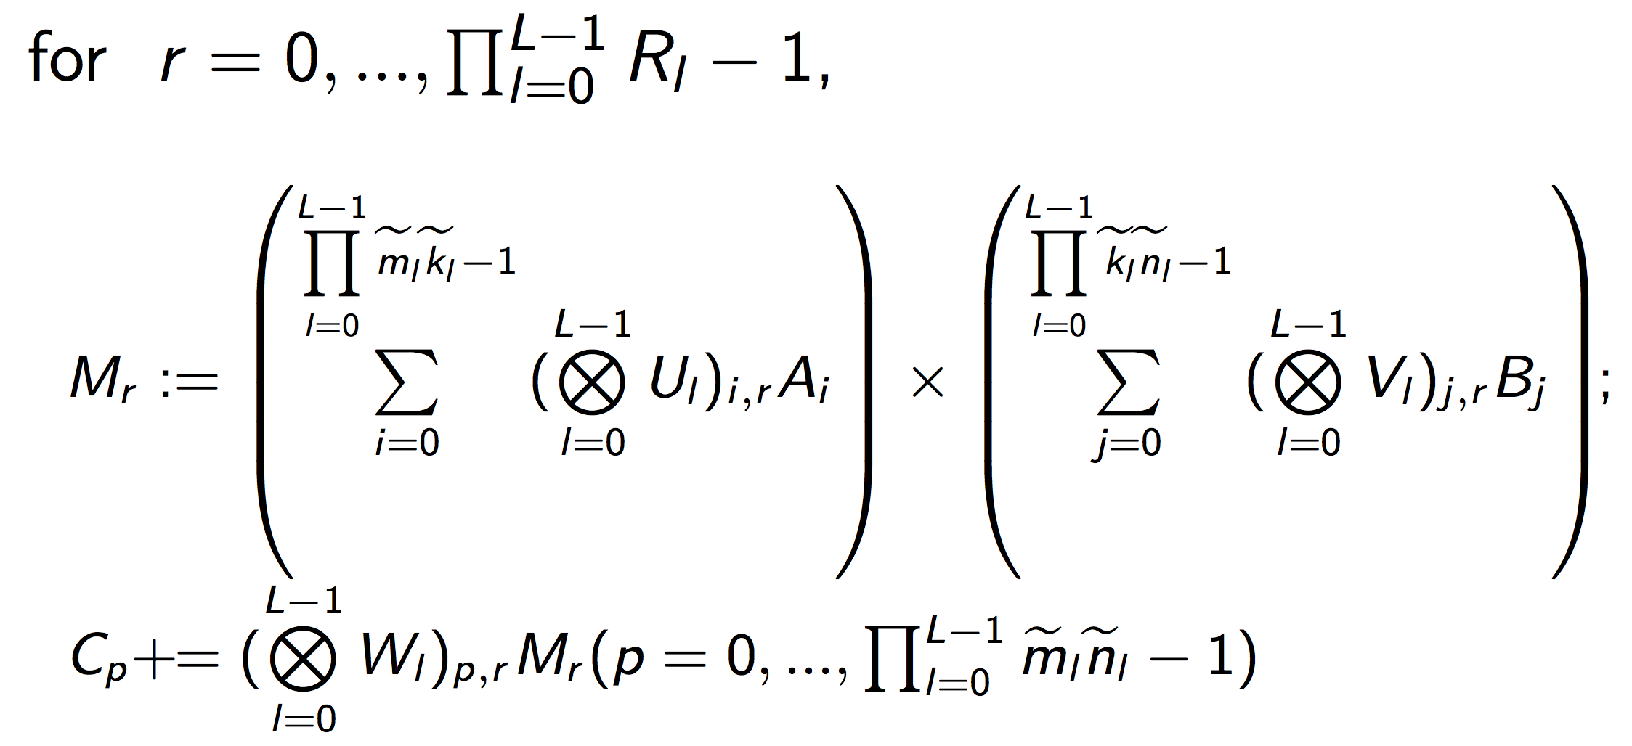
L-level Fast Matrix Multiplication
L-level Morton-like ordering index

Slide 30
Outline
Background
High-performance GEMM
High-performance Strassen
Fast Matrix Multiplication (FMM)
Code Generation
Performance Model
Experiments
Conclusion

Slide 31
Generating skeleton framework
Compute the Kronecker Product.
Generate matrix partitions by conceptually morton-like ordering indexing.
Fringes: dynamic peeling.
*Mithuna Thottethodi, Siddhartha Chatterjee, and Alvin R. Lebeck. "Tuning Strassen's matrix multiplication for memory efficiency." Proceedings of the 1998 ACM/IEEE conference on Supercomputing. IEEE Computer Society, 1998.

Slide 32
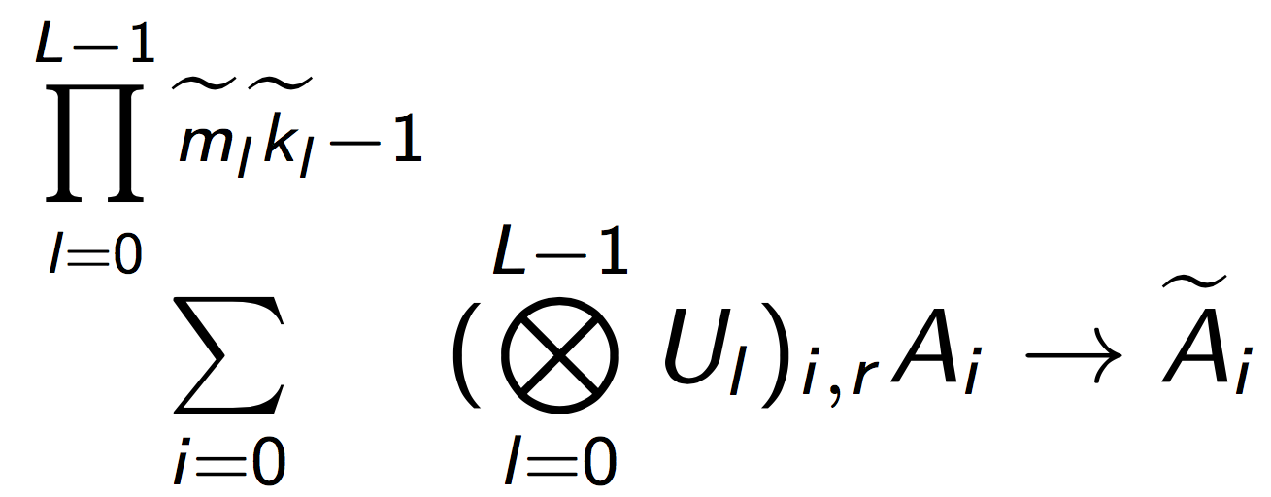
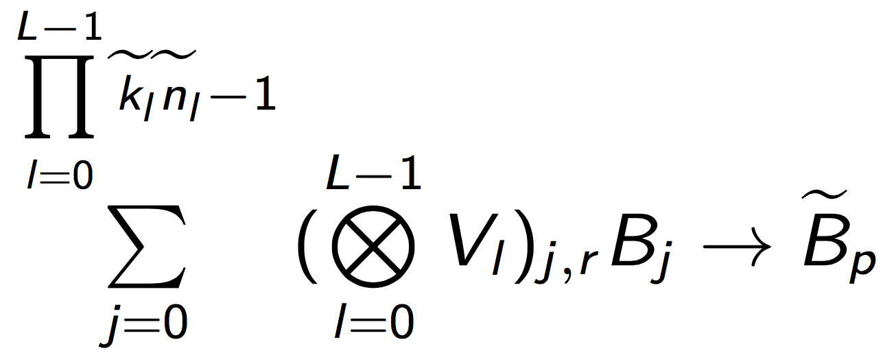
Generating typical operations
Packing routines:
Micro-kernel:
A hand-coded GEMM kernel
Automatically generated updates to multiple submatrices of C.

Slide 33
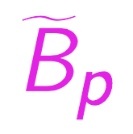
Variations on a theme
Naïve FMM
A traditional implementation with temporary buffers.
AB FMM
Integrate the addition of matrices into and .
ABC FMM
Integrate the addition of matrices into and .
Integrate the update of multiple submatrices of C in the micro-kernel.

Slide 34
Outline
Background
High-performance GEMM
High-performance Strassen
Fast Matrix Multiplication (FMM)
Code Generation
Performance Model
Experiments
Conclusion

Slide 35
Performance Model
Performance Metric
Total Time Breakdown
Arithmetic
Operations
Memory
Operations

Slide 36
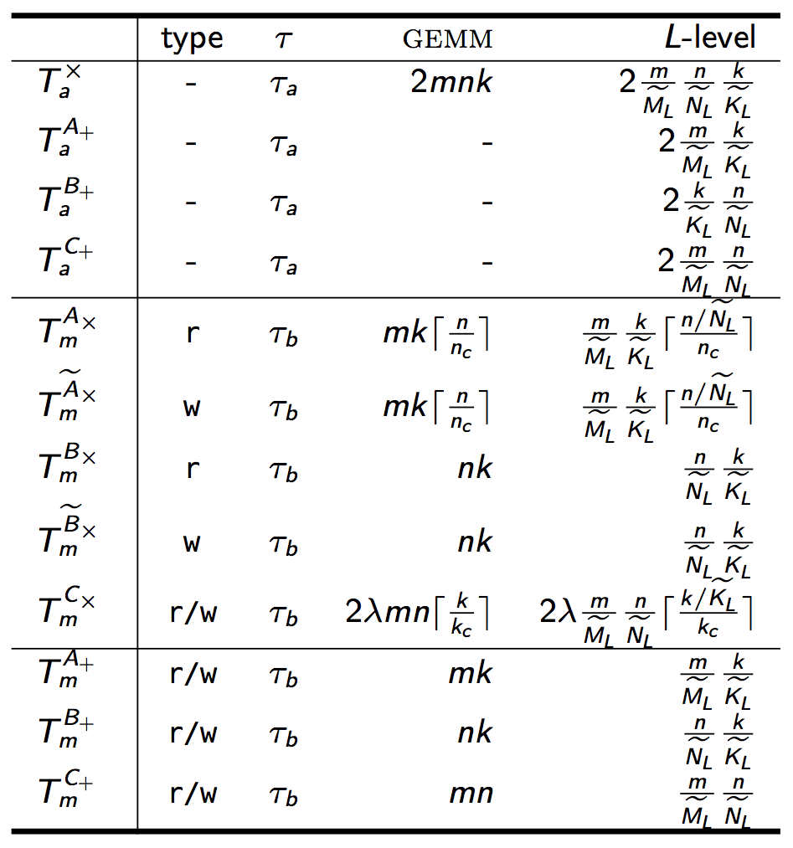
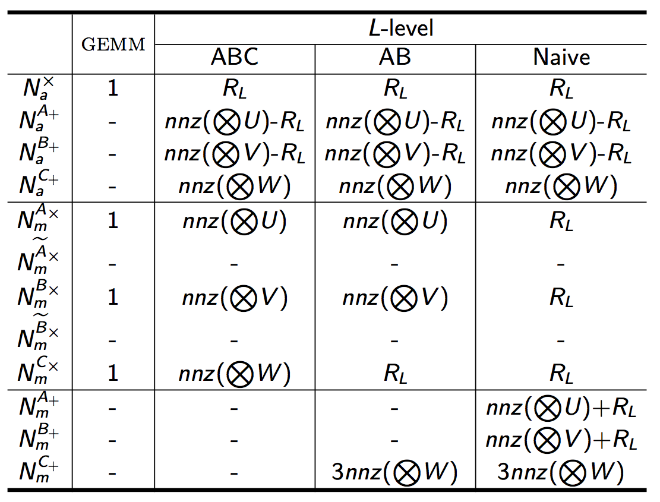

Slide 38
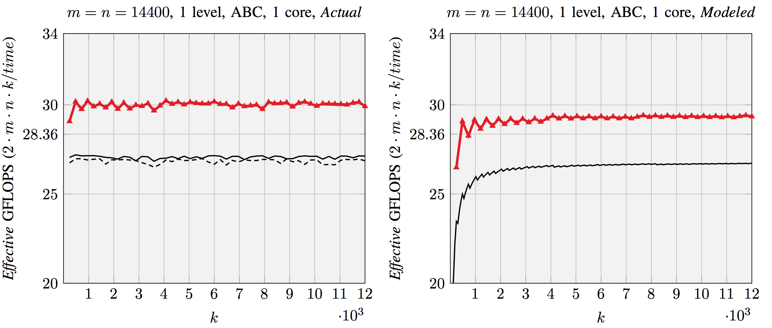
Actual vs. Modeled Performance
Intel Xeon E5-2680 v2 (Ivy Bridge, 10 core/socket)
Actual
Modeled

Slide 39
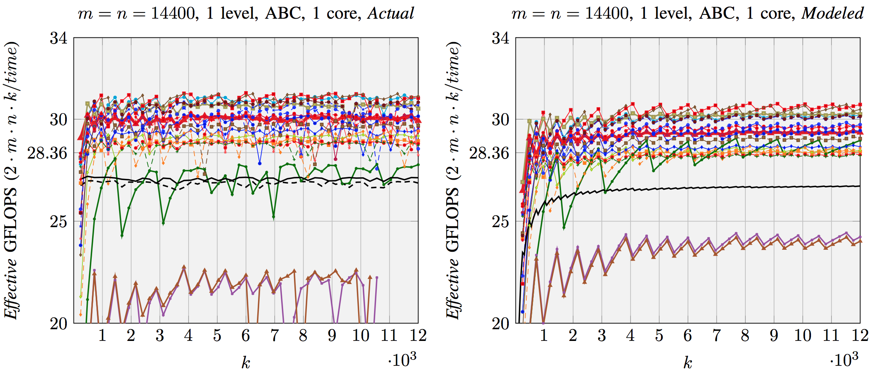
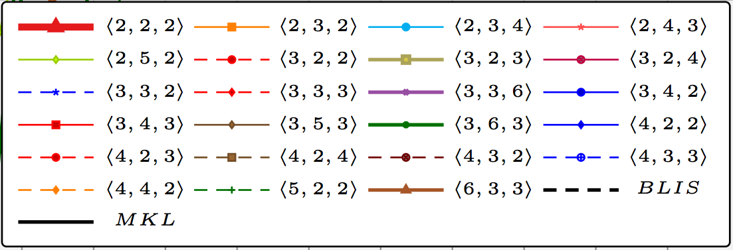
Actual vs. Modeled Performance
Intel Xeon E5-2680 v2 (Ivy Bridge, 10 core/socket)
Actual
Modeled

Slide 40
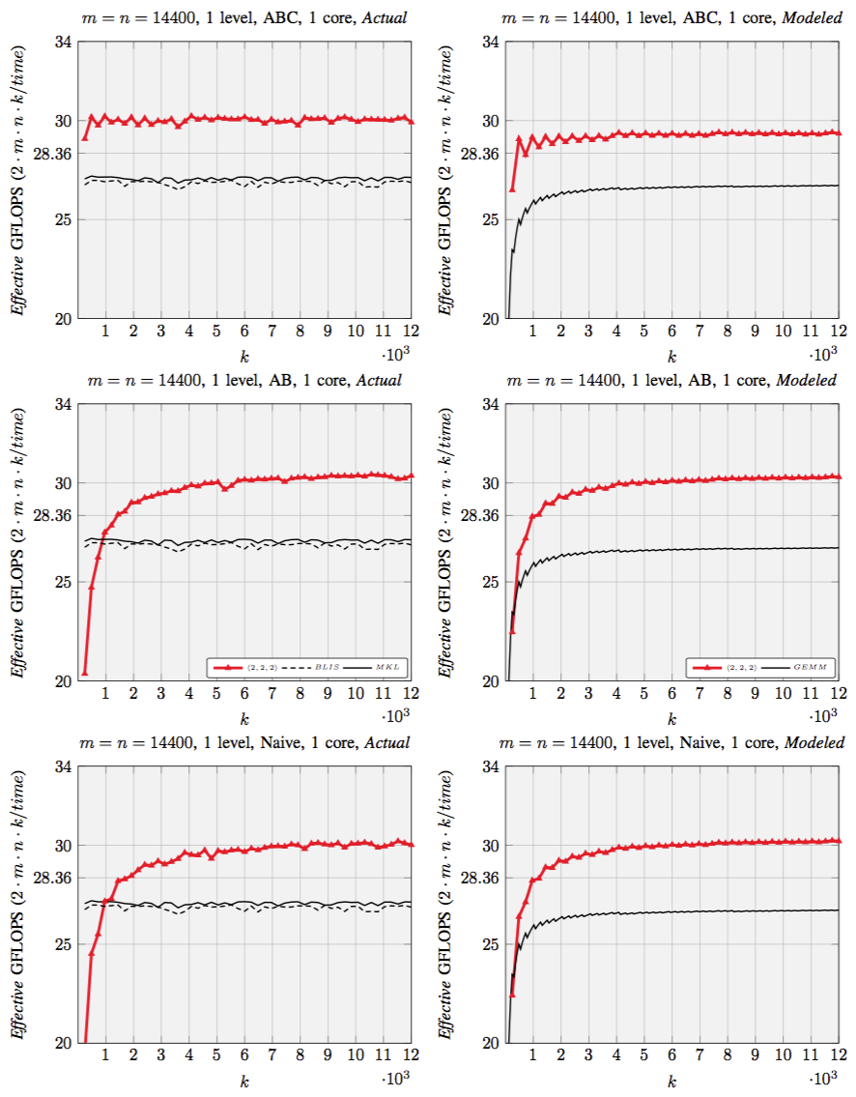
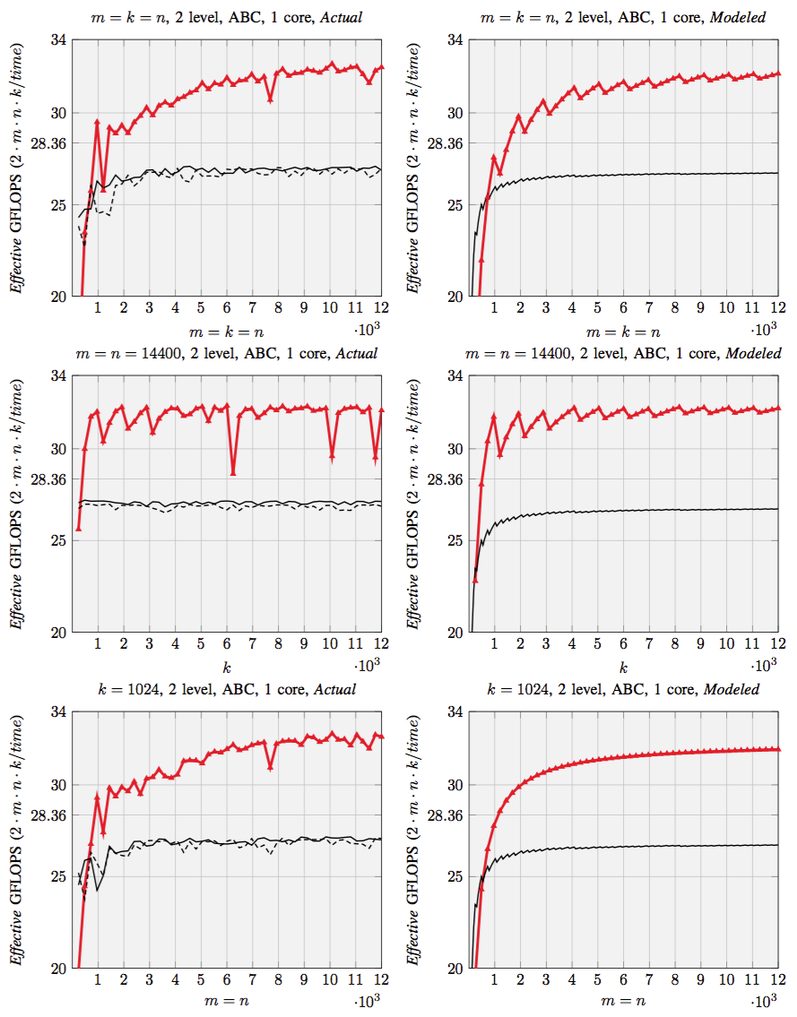
Actual
Modeled
Actual
Modeled

Slide 41
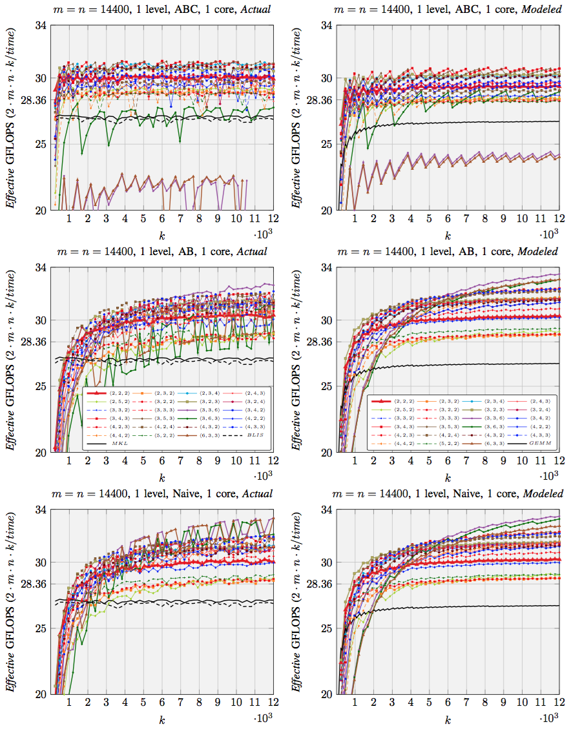
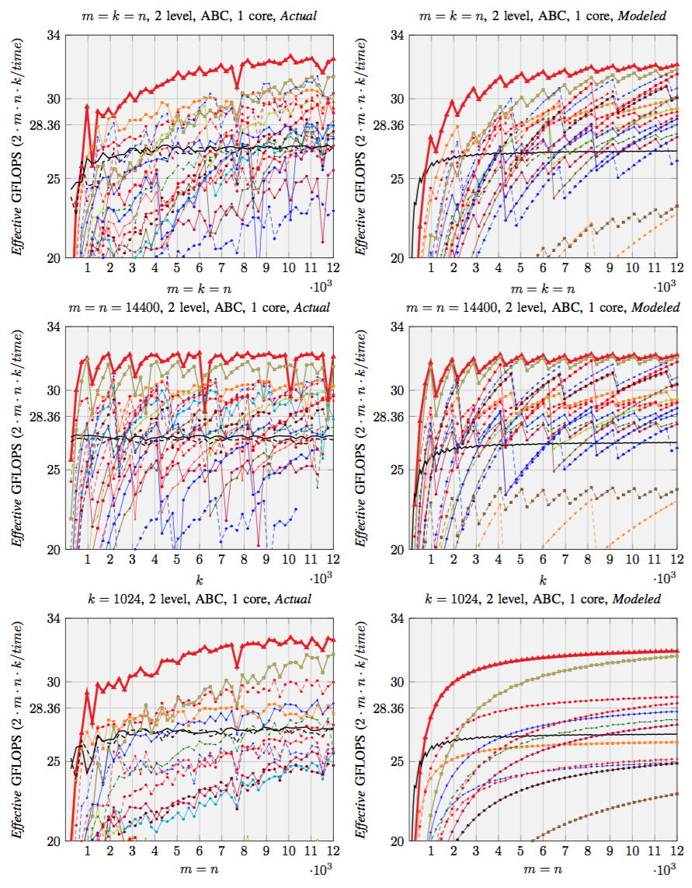
Actual
Modeled
Actual
Modeled

Slide 42
Selecting FMM implementation with performance model
Intel Xeon E5-2680 v2 (Ivy Bridge, 10 core/socket)
Best FMM: Best implementation among 20+ FMM with ABC, AB, Naïve implementations
Selected FMM: Selected FMM implementation with the guidance of performance model

Slide 43
Outline
Background
High-performance GEMM
High-performance Strassen
Fast Matrix Multiplication (FMM)
Code Generation
Performance Model
Experiments
Conclusion

Slide 44
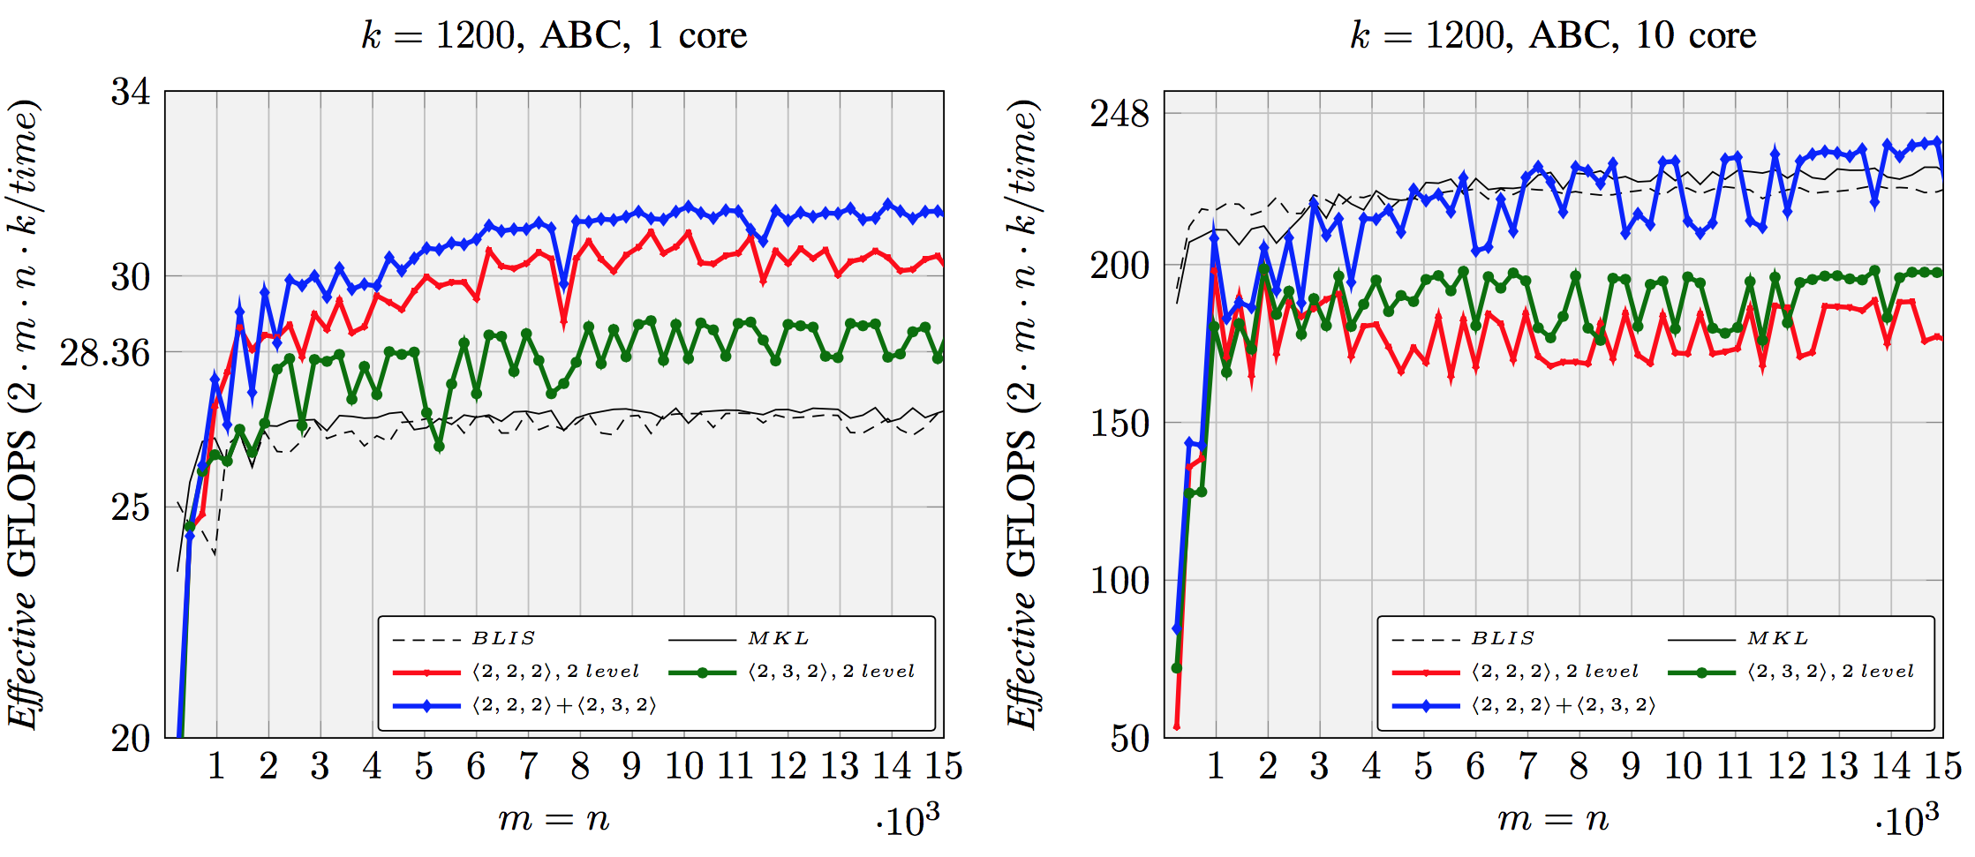
Hybrid Partitions
Intel Xeon E5-2680 v2 (Ivy Bridge, 10 core/socket)

Slide 45
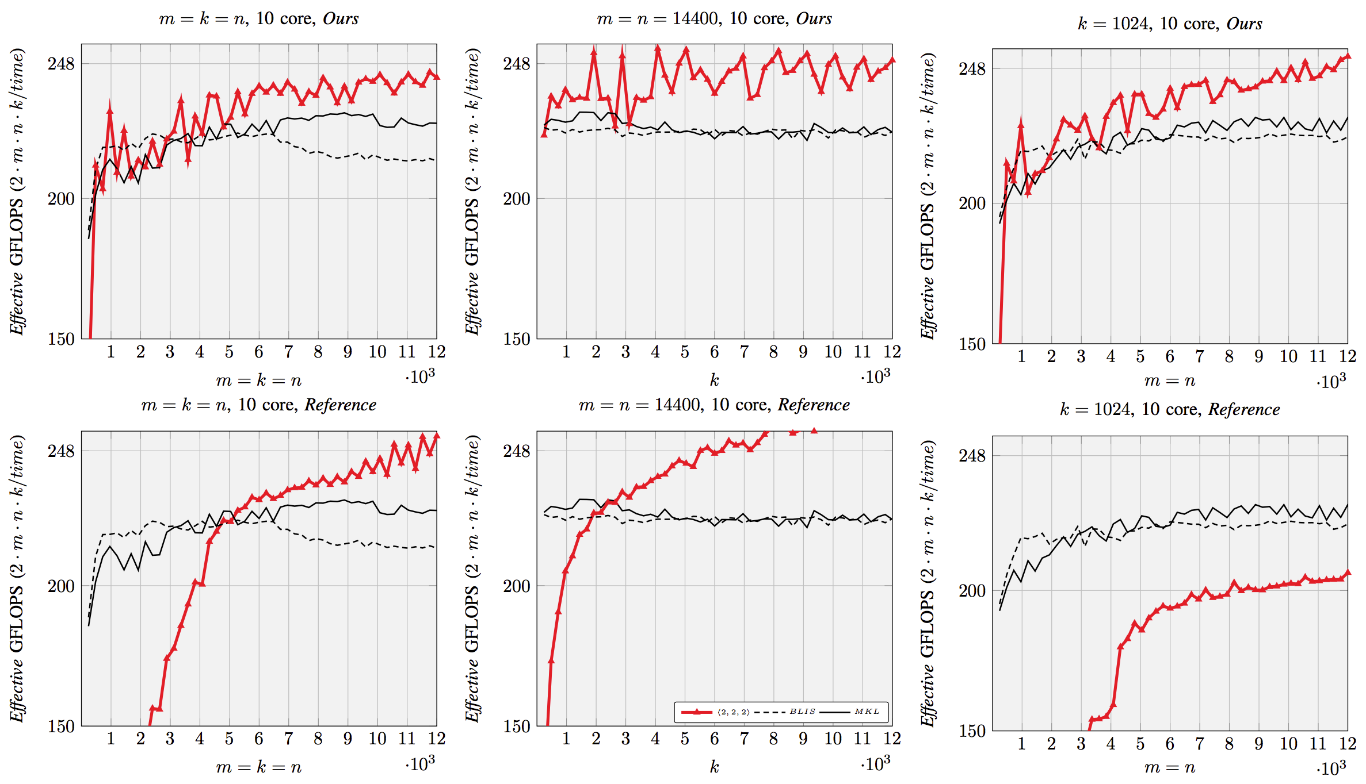
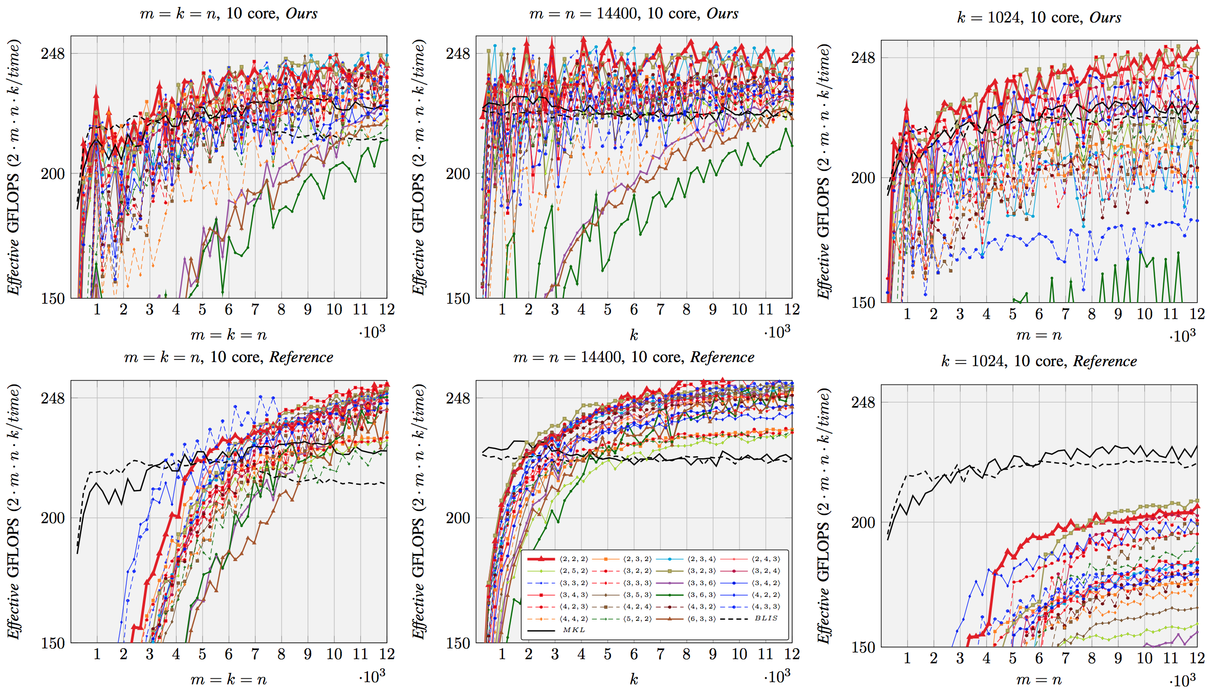
Parallel performance
Intel Xeon E5-2680 v2 (Ivy Bridge, 10 core/socket)
* Reference: Austin R. Benson, and Grey Ballard. "A framework for practical parallel fast matrix multiplication." in PPoPP2015.

Slide 46
Parallel performance
Intel Xeon E5-2680 v2 (Ivy Bridge, 10 core/socket)
* Reference: Austin R. Benson, and Grey Ballard. "A framework for practical parallel fast matrix multiplication." in PPoPP2015.

Slide 47
Outline
Background
High-performance GEMM
High-performance Strassen
Fast Matrix Multiplication (FMM)
Code Generation
Performance Model
Experiments
Conclusion

Slide 48
Our code generator …
Implement families of FMM algorithms automatically.
Express multi-level FMM as Kronecker product.
Incorporate matrix summations into operations inside GEMM.
Generate relatively accurate performance model.

Slide 49
Acknowledgement
- NSF grants ACI-1550493.
- A gift from Qualcomm Foundation.
- Intel Corporation through an Intel Parallel Computing Center (IPCC).
- Access to the Maverick and Stampede supercomputers administered by TACC.
We thank Austin Benson and Grey Ballard for sharing their open source code and helpful discussions, the anonymous reviewers for their constructive comments, and the rest of the SHPC team (http://shpc.ices.utexas.edu) for their supports.
Any opinions, findings, and conclusions or recommendations expressed in this material are those of the author(s) and do not necessarily reflect the views of the National Science Foundation.

Slide 50
Thank you!
The source code can be downloaded from:
https://github.com/flame/fmm-gen

Slide 51
Related work
[1]: Systematic way to identity and implement new FMM algorithms based on conventional calls to GEMM.
[2]: Strassen can be incorporated into high-performance GEMM
[3]: Kronecker product for expressing multi-level Strassen’s algorithm
*[1] Austin R. Benson, Grey Ballard. "A framework for practical parallel fast matrix multiplication." PPoPP15.
*[2] Jianyu Huang, Tyler Smith, Greg Henry, and Robert van de Geijn. “Strassen’s Algorithm Reloaded.” In SC’16.
*[3] C-H Huang, Jeremy R. Johnson, and Robert W. Johnson. "A tensor product formulation of Strassen's matrix multiplication algorithm." Applied Mathematics Letters 3.3 (1990): 67-71.

